Slide 1
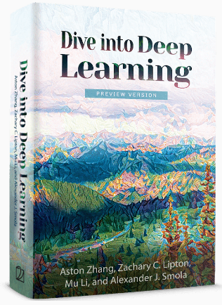
Dive into Deep Learning
Chapter 3:
Linear Neural Networks Linear Regression Implementation from Scratch

Slide 2
Contents
Linear Regression
Generating the Dataset
Reading the Dataset
Concise Implementation of Linear Regression
Generating the Dataset
Implementation of Softmax Regression from Scratch
Concise Implementation of Softmax Regression
The Image Classification Dataset
Linear Regression Implementation from Scratch
Initializing Model Parameters
Defining the Model
Initializing Model Parameters
Basic Elements of Linear Regression
Vectorization for Speed
The Normal Distribution and Squared Loss
From Linear Regression to Deep Networks
Reading the Dataset
Defining the Loss Function
Reading the Dataset
Reading a Minibatch
Putting All Things Together
Initializing Model Parameters
Defining the Softmax Operation
Defining the Model
Defining the Loss Function
Initializing Model Parameters
Softmax Implementation Revisited
Optimization Algorithm
Defining the Optimization Algorithm
Softmax Regression
Classification Problem
Network Architecture
Softmax Operation
Vectorization for Minibatches
Loss Function
Information Theory Basics
Defining the Model
Defining the Loss Function
Defining the Optimization Algorithm
Training
Training
Model Prediction and Evaluation
Classification Accuracy
Training
Prediction
Training

Slide 3
Contents
CH2
Linear Regression
Linear Regression Implementation from Scratch
Concise Implementation of Linear Regression
Softmax Regression
The Image Classification Dataset
Implementation of Softmax Regression from Scratch
Concise Implementation of Softmax Regression
Basic Elements of Linear Regression
Generating the Dataset
Generating the Dataset
Classification Problem
Reading the Dataset
Initializing Model Parameters
Initializing Model Parameters
Vectorization for Speed
Reading the Dataset
Reading the Dataset
Network Architecture
Reading a Minibatch
Defining the Softmax Operation
Softmax Implementation Revisited
The Normal Distribution and Squared Loss
Initializing Model Parameters
Defining the Model
Softmax Operation
Putting All Things Together
Defining the Model
Optimization Algorithm
From Linear Regression to Deep Networks
Defining the Model
Initializing Model Parameters
Vectorization for Minibatches
Defining the Loss Function
Training
Defining the Loss Function
Defining the Loss Function
Loss Function
Classification Accuracy
Defining the Optimization Algorithm
Defining the Optimization Algorithm
Information Theory Basics
Training
Training
Training
Model Prediction and Evaluation
Prediction

Slide 4

Linear Regression Implementation from Scratch
In this section, we will implement the entire method from scratch:
Data pipeline
Model
Loss function
Minibatch stochastic gradient descent optimizer.
We will rely only on tensors and auto differentiation.
%matplotlib inline
from d2l import mxnet as d2l
from mxnet import autograd, np, npx
import random
npx.set_np()

Slide 5
Contents
CH2
Linear Regression
Linear Regression Implementation from Scratch
Concise Implementation of Linear Regression
Softmax Regression
The Image Classification Dataset
Implementation of Softmax Regression from Scratch
Concise Implementation of Softmax Regression
Basic Elements of Linear Regression
Generating the Dataset
Generating the Dataset
Classification Problem
Reading the Dataset
Initializing Model Parameters
Initializing Model Parameters
Vectorization for Speed
Reading the Dataset
Reading the Dataset
Network Architecture
Reading a Minibatch
Defining the Softmax Operation
Softmax Implementation Revisited
The Normal Distribution and Squared Loss
Initializing Model Parameters
Defining the Model
Softmax Operation
Putting All Things Together
Defining the Model
Optimization Algorithm
From Linear Regression to Deep Networks
Defining the Model
Initializing Model Parameters
Vectorization for Minibatches
Defining the Loss Function
Training
Defining the Loss Function
Defining the Loss Function
Loss Function
Classification Accuracy
Defining the Optimization Algorithm
Defining the Optimization Algorithm
Information Theory Basics
Training
Training
Training
Model Prediction and Evaluation
Prediction

Slide 6
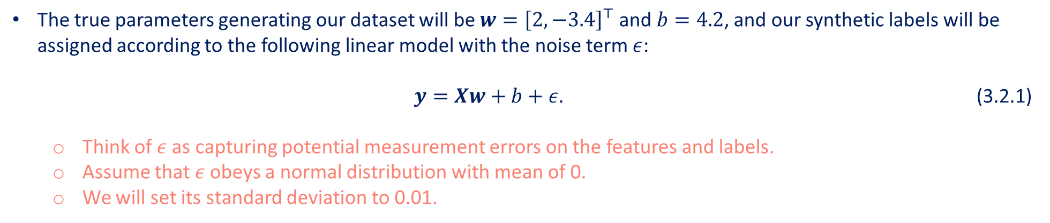
Generating the Dataset
We will construct an artificial dataset according to a linear model with additive noise.
We generate a dataset containing 1000 examples, each consisting of 2 features sampled from a standard normal distribution.
Our synthetic dataset will be a matrix $X∈R^{1000×2}$.
The true parameters generating our dataset will be $w={\left[2,−3.4\right]}^{⊤}$ and $b=4.2$, and our synthetic labels will be assigned according to the following linear model with the noise term $ε$:
$y=Xw+b+ε$. (3.2.1)
Think of $ε$ as capturing potential measurement errors on the features and labels.
Assume that $ε$ obeys a normal distribution with mean of 0.
We will set its standard deviation to 0.01.

Slide 7
Generating the Dataset
The following code generates our synthetic dataset.
def synthetic_data(w, b, num_examples): #@save
"""Generate y = Xw + b + noise."""
X = np.random.normal(0, 1, (num_examples, len(w)))
y = np.dot(X, w) + b
y += np.random.normal(0, 0.01, y.shape)
return X, y.reshape((-1, 1))
true_w = np.array([2, -3.4])
true_b = 4.2
features, labels = synthetic_data(true_w, true_b, 1000)
Each row in features consists of a 2-dimensional data example.
Each row in labels consists of a 1-dimensional label value (a scalar).
print('features:', features[0],'\nlabel:', labels[0])

Slide 8
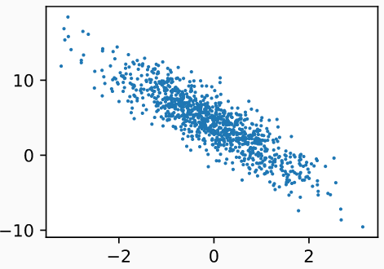
Generating the Dataset
Generate a scatter plot using the second feature features[:, 1] and labels.
d2l.set_figsize()
# The semicolon is for displaying the plot only
d2l.plt.scatter(d2l.numpy(features[:, 1]), d2l.numpy(labels), 1);

Slide 9
Contents
CH2
Linear Regression
Linear Regression Implementation from Scratch
Concise Implementation of Linear Regression
Softmax Regression
The Image Classification Dataset
Implementation of Softmax Regression from Scratch
Concise Implementation of Softmax Regression
Basic Elements of Linear Regression
Generating the Dataset
Generating the Dataset
Classification Problem
Reading the Dataset
Initializing Model Parameters
Initializing Model Parameters
Vectorization for Speed
Reading the Dataset
Reading the Dataset
Network Architecture
Reading a Minibatch
Defining the Softmax Operation
Softmax Implementation Revisited
The Normal Distribution and Squared Loss
Initializing Model Parameters
Defining the Model
Softmax Operation
Putting All Things Together
Defining the Model
Optimization Algorithm
From Linear Regression to Deep Networks
Defining the Model
Initializing Model Parameters
Vectorization for Minibatches
Defining the Loss Function
Training
Defining the Loss Function
Defining the Loss Function
Loss Function
Classification Accuracy
Defining the Optimization Algorithm
Defining the Optimization Algorithm
Information Theory Basics
Training
Training
Training
Model Prediction and Evaluation
Prediction

Slide 10
Reading the Dataset
Training models consists of:
Making multiple passes over the dataset,
Grabbing one minibatch of examples at a time,
Using them to update our model.
The training process is so fundamental to machine learning algorithms,
It is worth defining a utility function to shuffle the dataset and access it in minibatches.
The $data_iter$ function takes a batch size, a matrix of features, and a vector of labels, yielding minibatches of the size $batch_size$.
Each minibatch consists of a tuple of features and labels.
def data_iter(batch_size, features, labels):
num_examples = len(features)
indices = list(range(num_examples))
# The examples are read at random, in no particular order
random.shuffle(indices)
for i in range(0, num_examples, batch_size):
batch_indices = np.array(
indices[i: min(i + batch_size, num_examples)])
yield features[batch_indices], labels[batch_indices]

Slide 11
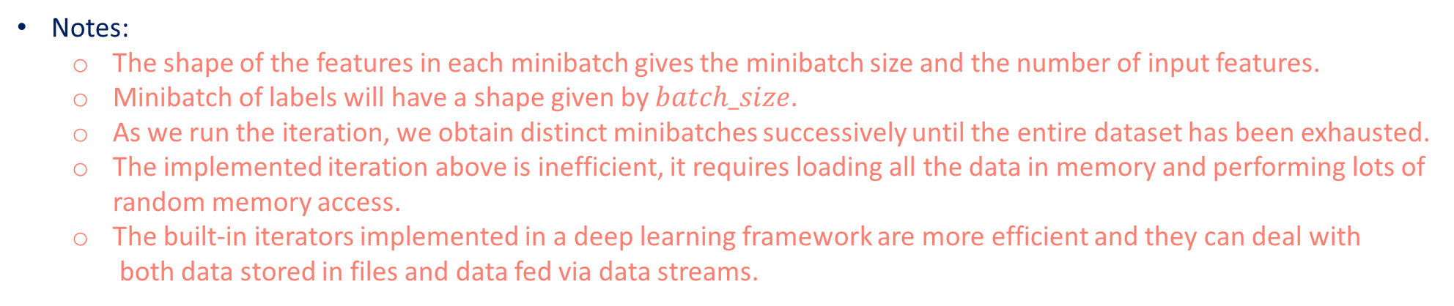
Reading the Dataset
We want to use reasonably sized minibatches to take advantage of parallelizing operations using GPU hardware.
Each example can be fed through our models in parallel and the gradient of the loss function for each example can also be taken in parallel.
Let us read and print the first small batch of data examples.
batch_size = 10
for X, y in data_iter(batch_size, features, labels):
print(X, '\n', y)
break
Notes:
The shape of the features in each minibatch gives the minibatch size and the number of input features.
Minibatch of labels will have a shape given by $batch_size$.
As we run the iteration, we obtain distinct minibatches successively until the entire dataset has been exhausted.
The implemented iteration above is inefficient, it requires loading all the data in memory and performing lots of random memory access.
The built-in iterators implemented in a deep learning framework are more efficient and they can deal with both data stored in files and data fed via data streams.

Slide 12
Contents
CH2
Linear Regression
Linear Regression Implementation from Scratch
Concise Implementation of Linear Regression
Softmax Regression
The Image Classification Dataset
Implementation of Softmax Regression from Scratch
Concise Implementation of Softmax Regression
Basic Elements of Linear Regression
Generating the Dataset
Generating the Dataset
Classification Problem
Reading the Dataset
Initializing Model Parameters
Initializing Model Parameters
Vectorization for Speed
Reading the Dataset
Reading the Dataset
Network Architecture
Reading a Minibatch
Defining the Softmax Operation
Softmax Implementation Revisited
The Normal Distribution and Squared Loss
Initializing Model Parameters
Defining the Model
Softmax Operation
Putting All Things Together
Defining the Model
Optimization Algorithm
From Linear Regression to Deep Networks
Defining the Model
Initializing Model Parameters
Vectorization for Minibatches
Defining the Loss Function
Training
Defining the Loss Function
Defining the Loss Function
Loss Function
Classification Accuracy
Defining the Optimization Algorithm
Defining the Optimization Algorithm
Information Theory Basics
Training
Training
Training
Model Prediction and Evaluation
Prediction

Slide 13
Initializing Model Parameters
In the following code, we initialize weights by sampling random numbers from a normal distribution with mean 0 and a standard deviation of 0.01, and setting the bias to 0.
w = np.random.normal(0, 0.01, (2, 1))
b = np.zeros(1)
w.attach_grad()
b.attach_grad()
After initializing our parameters, our next task is to update them until they fit our data sufficiently well.
Each update requires taking the gradient of our loss function with respect to the parameters.
Given this gradient, we can update each parameter in the direction that may reduce the loss.
We will use automatic differentiation.

Slide 14
Contents
CH2
Linear Regression
Linear Regression Implementation from Scratch
Concise Implementation of Linear Regression
Softmax Regression
The Image Classification Dataset
Implementation of Softmax Regression from Scratch
Concise Implementation of Softmax Regression
Basic Elements of Linear Regression
Generating the Dataset
Generating the Dataset
Classification Problem
Reading the Dataset
Initializing Model Parameters
Initializing Model Parameters
Vectorization for Speed
Reading the Dataset
Reading the Dataset
Network Architecture
Reading a Minibatch
Defining the Softmax Operation
Softmax Implementation Revisited
The Normal Distribution and Squared Loss
Initializing Model Parameters
Defining the Model
Softmax Operation
Putting All Things Together
Defining the Model
Optimization Algorithm
From Linear Regression to Deep Networks
Defining the Model
Initializing Model Parameters
Vectorization for Minibatches
Defining the Loss Function
Training
Defining the Loss Function
Defining the Loss Function
Loss Function
Classification Accuracy
Defining the Optimization Algorithm
Defining the Optimization Algorithm
Information Theory Basics
Training
Training
Training
Model Prediction and Evaluation
Prediction

Slide 15
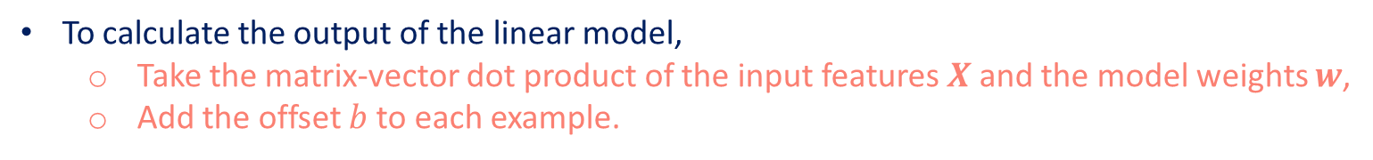
Defining the Model
Next, we must define our model, relating its inputs and parameters to its outputs.
To calculate the output of the linear model,
Take the matrix-vector dot product of the input features $X$ and the model weights $w$,
Add the offset $b$ to each example.
Note that $Xw$ is a vector and $b$ is a scalar.
So the broadcasting mechanism is applied (the scalar is added to each component of the vector).
def linreg(X, w, b): #@save
"""The linear regression model."""
return np.dot(X, w) + b

Slide 16
Contents
CH2
Linear Regression
Linear Regression Implementation from Scratch
Concise Implementation of Linear Regression
Softmax Regression
The Image Classification Dataset
Implementation of Softmax Regression from Scratch
Concise Implementation of Softmax Regression
Basic Elements of Linear Regression
Generating the Dataset
Generating the Dataset
Classification Problem
Reading the Dataset
Initializing Model Parameters
Initializing Model Parameters
Vectorization for Speed
Reading the Dataset
Reading the Dataset
Network Architecture
Reading a Minibatch
Defining the Softmax Operation
Softmax Implementation Revisited
The Normal Distribution and Squared Loss
Initializing Model Parameters
Defining the Model
Softmax Operation
Putting All Things Together
Defining the Model
Optimization Algorithm
From Linear Regression to Deep Networks
Defining the Model
Initializing Model Parameters
Vectorization for Minibatches
Defining the Loss Function
Training
Defining the Loss Function
Defining the Loss Function
Loss Function
Classification Accuracy
Defining the Optimization Algorithm
Defining the Optimization Algorithm
Information Theory Basics
Training
Training
Training
Model Prediction and Evaluation
Prediction

Slide 17
Defining the Loss Function
Updating our model requires taking the gradient of our loss function.
We will use the squared loss function.
We need to transform the true value y into the predicted value’s shape y_hat.
The result returned by the following function will also have the same shape as y_hat.
def squared_loss(y_hat, y): #@save
"""Squared loss."""
return (y_hat - y.reshape(y_hat.shape)) ** 2 / 2

Slide 18
Contents
CH2
Linear Regression
Linear Regression Implementation from Scratch
Concise Implementation of Linear Regression
Softmax Regression
The Image Classification Dataset
Implementation of Softmax Regression from Scratch
Concise Implementation of Softmax Regression
Basic Elements of Linear Regression
Generating the Dataset
Generating the Dataset
Classification Problem
Reading the Dataset
Initializing Model Parameters
Initializing Model Parameters
Vectorization for Speed
Reading the Dataset
Reading the Dataset
Network Architecture
Reading a Minibatch
Defining the Softmax Operation
Softmax Implementation Revisited
The Normal Distribution and Squared Loss
Initializing Model Parameters
Defining the Model
Softmax Operation
Putting All Things Together
Defining the Model
Optimization Algorithm
From Linear Regression to Deep Networks
Defining the Model
Initializing Model Parameters
Vectorization for Minibatches
Defining the Loss Function
Training
Defining the Loss Function
Defining the Loss Function
Loss Function
Classification Accuracy
Defining the Optimization Algorithm
Defining the Optimization Algorithm
Information Theory Basics
Training
Training
Training
Model Prediction and Evaluation
Prediction

Slide 19
Defining the Optimization Algorithm
At each step, using one minibatch randomly drawn from our dataset,
We will estimate the gradient of the loss with respect to our parameters.
Next, we will update our parameters in the direction that may reduce the loss.
The following code applies the minibatch stochastic gradient descent update, given a set of parameters, a learning rate (size of the update step, $lr$), and a batch size.
def sgd(params, lr, batch_size): #@save
"""Minibatch stochastic gradient descent."""
for param in params:
param[:] = param - lr * param.grad / batch_size
The loss is calculated as a sum over the minibatch of examples.
We normalize our step size by the batch size (batch_size), so that the magnitude of a typical step size does not depend heavily on our choice of the batch size.

Slide 20
Contents
CH2
Linear Regression
Linear Regression Implementation from Scratch
Concise Implementation of Linear Regression
Softmax Regression
The Image Classification Dataset
Implementation of Softmax Regression from Scratch
Concise Implementation of Softmax Regression
Basic Elements of Linear Regression
Generating the Dataset
Generating the Dataset
Classification Problem
Reading the Dataset
Initializing Model Parameters
Initializing Model Parameters
Vectorization for Speed
Reading the Dataset
Reading the Dataset
Network Architecture
Reading a Minibatch
Defining the Softmax Operation
Softmax Implementation Revisited
The Normal Distribution and Squared Loss
Initializing Model Parameters
Defining the Model
Softmax Operation
Putting All Things Together
Defining the Model
Optimization Algorithm
From Linear Regression to Deep Networks
Defining the Model
Initializing Model Parameters
Vectorization for Minibatches
Defining the Loss Function
Training
Defining the Loss Function
Defining the Loss Function
Loss Function
Classification Accuracy
Defining the Optimization Algorithm
Defining the Optimization Algorithm
Information Theory Basics
Training
Training
Training
Model Prediction and Evaluation
Prediction

Slide 21
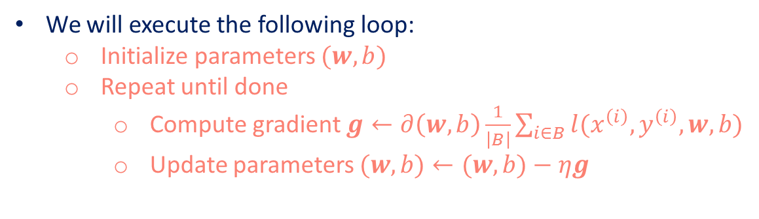
Training
We will execute the following loop:
Initialize parameters $(w,b)$
Repeat until done
Compute gradient $g←∂\left(w,b\right)\frac{1}{\left|B\right|}\sum_{i∈B}{l(x^{\left(i\right)},y^{\left(i\right)},w,b)}$
Update parameters $(w,b)←(w,b)−ηg$
Grab a minibatch of training examples
Pass them to the model to obtain a set of predictions
Calculate the loss
Backward through the network, storing the gradients with respect to each parameter
Call the sgd to update the model parameters.
In each epoch, iterate through the entire dataset (using the $data_iter$ function) once passing through every example in the training dataset.
Assuming that the number of examples is divisible by the batch size.
The number of epochs $num_epochs$ and the learning rate $lr$ are both hyperparameters, which we set to 3 and 0.03, respectively.
Setting hyperparameters is tricky and requires some adjustment by trial and error.

Slide 22
Training
lr = 0.03
num_epochs = 3
net = linreg
loss = squared_loss
for epoch in range(num_epochs):
for X, y in data_iter(batch_size, features, labels):
with autograd.record():
l = loss(net(X, w, b), y) # Minibatch loss in `X` and `y`
# Because `l` has a shape (`batch_size`, 1) and is not a scalar
# variable, the elements in `l` are added together to obtain a new
# variable, on which gradients with respect to [`w`, `b`] are computed
l.backward()
sgd([w, b], lr, batch_size) # Update parameters using their gradient
train_l = loss(net(features, w, b), labels)
print(f'epoch {epoch + 1}, loss {float(train_l.mean()):f}')

Slide 23
Training
Because we synthesized the dataset ourselves, we know precisely what the true parameters are.
Thus, we can evaluate our success in training by comparing the true parameters with those that we learned through our training loop.
They turn out to be very close to each other.
print(f'error in estimating w: {true_w - w.reshape(true_w.shape)}')
print(f'error in estimating b: {true_b - b}')
Note that we should not take it for granted that we are able to recover the parameters perfectly.
We are less concerned with recovering true underlying parameters, and more concerned with parameters that lead to highly accurate prediction.
Even on difficult optimization problems, stochastic gradient descent can often find remarkably good solutions.
Owing partly to the fact that, for deep networks, there exist many configurations of the parameters that lead to highly accurate prediction.

Slide 24
Summary
We saw how a deep network can be implemented and optimized from scratch, using just tensors and auto differentiation, without any need for defining layers or fancy optimizers.
This section only scratches the surface of what is possible. In the following sections, we will describe additional models based on the concepts that we have just introduced and learn how to implement them more concisely.

